Slide 1


Regression Analysis

Slide 2
Learning Objectives
Participants should understand the theory and application of Regression, the challenges faced by analyst in carrying out regression, Types of Regression Algorithm, and how to draw inferences from linear regression.

Slide 3
Introduction
Machine learning is applied to solve the regression problem using two different kinds of regression analysis techniques: logistic regression and linear regression. They are the most well-known regression algorithms. Regression analysis techniques in machine learning come in various types, and their use depends on the type of data used.

Slide 4
Regression Analysis
A Regression analysis examines the relationship between the goal or dependent variable and independent variable in a dataset. When the target and independent variables exhibit a linear or non-linear relationship between one another and the target variable has continuous values, the Linear regression analysis techniques is applied. Regression analysis is frequently used to identify cause and effect relationships, forecast trends, time series, and predictor strength.
The main method for resolving regression issues in machine learning with data modeling is regression analysis. Finding the best fit line, or a line that passes through all of the data points such that the distance between the line and each data point is minimal.

Slide 5
Scatter Plot
A scatter plot is a type of plot which uses Centroid to display values for typically two variables for a set of data. It is known as a scatter graph, scatter chart, scattergram, or scatter diagram. The information is shown as a series of points, with each point's value determining its location on the horizontal axis and its value dictating its position on the vertical axis.
A scatter plot is often used to show the relationship between two variables graphically.
Correlation analysis is used to measure strength of the linear relationship association between two variables. Correlation does not mean causation. Hence, no causal effect is implied with correlation The type of model built depends upon the type of variables and the type of relationship that exists between the variables.

Slide 6
Types of Regression Analysis
Regression analysis approaches come in a wide variety, and the amount of components will determine which technique is used. The kind of target variable, the pattern of the regression line, and the quantity of independent variables are some examples of these variables.
Linear Regression
Logistic Regression
Ridge Regression
Lasso Regression
Polynomial Regression
Bayesian Linear Regression

Slide 7
Linear Regression
One of the most basic kinds of regression in machine learning is linear regression. It is used for predicting two variable that are linearly related to one another. When the number of independent variable is more than two we refer to it as multiple linear regression. The linear regression model is represented by the equation shown below:
y=mx+c+e
where m is the line's slope, c is its intercept, and e stands for the model's error.

Slide 8
Assumptions of Linear Regression
Linear relationship between dependent and independent variables ( This assumption can be tested through scatter plot)
Normality of residuals (This assumption can be checked by looking at a histogram or a Q-Q-Plot of the residuals. Normality can also be checked with a goodness of fit test (e.g., the Kolmogorov-Smirnov test).
The data come from a random sample of size n from the population of interest or a randomized experiment
Constant variance assumption.

Slide 9
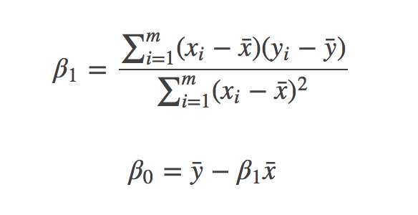


Simple Linear Regression
In Simple Linear Regression, there is one response variable (Y), one predictor variable (X) and the relationship between the response and predictor variable is linear
The regression equation:
y = β₀ + β₁X₁ + e
y: dependent variable
β₀ : Intercept
β₁ : Slope
X₁: independent variable
e : error term

Slide 10
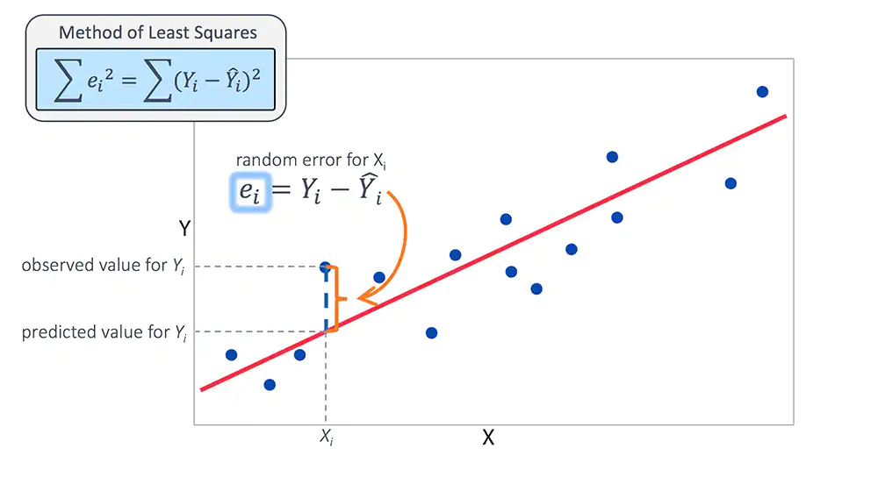
Residual
The residual also known as the error term is the difference between the observed value and the predicted value. In regression modelling, we are always interested in the model that minimises the residual sum of squares (RSS)

Slide 11
Case Study 1
As a data scientist, a client approached you to analyze his business data. He wants to know if there is a significant relationship between the Age and the Income of his customers who purchased his treadmill products. We start by loading the data set into R.
library(ggplot2)
library(readr)
dt<-read.csv("data/Gym.csv", header = T)
p1<-ggplot(dt, aes(x=Age, y=Income))+geom_point()+
labs(title = "Relationship between Income and Age",
xlab="Age", ylab="Income")
scatter.smoth(df$Age, df$Income)

Slide 12
Case Study 1
What do you observe in the scatter plot? You can see that there is a moderate positive linear relationship between the Age and the Income of the Customers. As their age increases so does their income also increases.
Since we have established that there is a linear relationship between Age and Income. Let’s see if there is a causal relationship using regression modeling, does their age affects their Income?
To fit a linear regression model in R, we use the lm function.
m1<-lm(Income~Age, data = dt)
Call:
lm(formula = Income ~ Age, data = cv)
Residuals:
Min 1Q Median 3Q Max
-26220 -8844 -4267 2852 48138
Coef:Estimate Std. Error t value Pr(>|t|)
(Intercept) 18581.8 4527.6 4.104 6.17e-05 ***
Age 1220.5 152.9 7.982 1.71e-13 ***
---
Signif. codes: 0 ‘***’ 0.001 ‘**’ 0.01 ‘*’ 0.05 ‘.’ 0.1 ‘ ’ 1
Residual standard error: 14200 on 178 degrees of freedom
Multiple R-squared: 0.2636, Adjusted R-squared: 0.2595
F-statistic: 63.71 on 1 and 178 DF, p-value: 1.708e-13

Slide 13
Case Study 1
The output depicts that the linear equation is y= 18581.8 + 1220.5(Age) Since the P-value of 1.71e-13 of the coefficient of Age (slope) is less than 0.05, it indicates that the Age has significant effect on Income.
The intercept is also significant at 5% level of significance. To interpret the coefficient of Age (slope), for a unit increase in the Age, the Income increases by 1220.5. The Adjusted R-squared is interpreted as the amount of variation of the dependent variable that can be explained by the independent variable. For the model, the 25.95% of the total variation in Income can be explained by the Age.

Slide 14
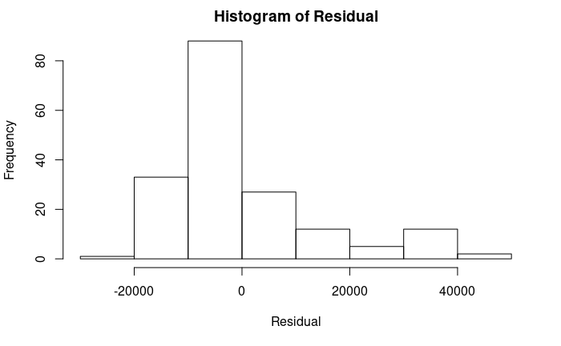
Normality of Residuals
The residuals are skewed to the right, which indicates that the assumption of normality of residuals has been violated. We can
rectify this by taking log transformation of our variables.

Slide 15
Multiple Linear Regression
As we can see from the simple regression model in case study 1, we have a weak model with just 25.95% of the total variation in Income explained by the Age. We can improve this model through multiple regression model by adding more variable in the model.
Let’s add Education level to the model, we want to know if their Age and education level have effect on their income.
m2<-lm(Income~Age+Education, data = dt)

Slide 16
Case Study 2
Call:
lm(formula = Income ~ Age + Education, data = cv)
Residuals:
Min 1Q Median 3Q Max
-25641 -7551 -1914 4420 40395
Coefficients: Estim Std. Error t value Pr(>|t|)
(Intercept) -54508.6 8461.0 -6.442 1.08e-09 ***
Age 871.8 129.6 6.728 2.29e-10 ***
Education 5338.3 556.4 9.595 < 2e-16 ***
---
Signif. codes: 0 ‘***’ 0.001 ‘**’ 0.01 ‘*’ 0.05 ‘.’ 0.1 ‘ ’ 1
Residual standard error: 11550 on 177 degrees of freedom
Multiple R-squared: 0.5156, Adjusted R-squared: 0.5101
F-statistic: 94.19 on 2 and 177 DF, p-value: < 2.2e-16

Slide 17
Case Study 2
Look at the Adjusted R-squared, by adding education to the model,our model improved by 25%. Hence, far better than our previous model.
The output depicts that the linear equation is
y= -54508.6 + 871.8(Age) + 5338.3(Education)
Since the P-value of 2.29e-10 of the coefficient of Age is less than 0.05, this indicates that the Age has significant effect on their income.
Also the P-value of the coefficient of Education is less than 0.05, this indicates that the Education also has significant effect on their Income.

Slide 18
Case Study 2
The intercept is also significant at 5% level of significance.
To interpret the coefficient of Age , for a unit increase in the Age, the Income increases by 871.8.00
To interpret the coefficient of Education , for a unit increase in the Education level, the Income increases by 5338.3 Hence, the higher the Age and Education, the higher their income.
For the multiple regression model, 51.01% of the total variation in Income can be explained by Age and Education. This indicates an improved model.

Slide 19
Application of Model
So let’s say the client is interested in using the model for prediction. He wants to predict what the expected income of a customer who is 50 years old and has spent 15 years on Education.
To do this in R, we can obtain both the predicted value and 95% prediction interval using the Predict Function.
newdata<-data.frame(Age=c(50), Education=c(15))
newdata
## Age Education
## 1 50 15
predict(m2, newdata = newdata, interval = ’prediction’)
## fit lwr upr
## 1 69156.93 45609.63 92704.22

Slide 20
Application of Model
The predicted income is 69156.93 with a Prediction interval of 45609.63 and 92704.22. The prediction interval indicates that we are 95% confident that the person whose Age is 50 and has spent 15 years on education will have an income that falls between the range 45609.63 and 92704.22.

Slide 21
Task
Use the temperature dataset to predict the room temperature given the following variables “Humidity”, “Co2”, “”Light”

Slide 22
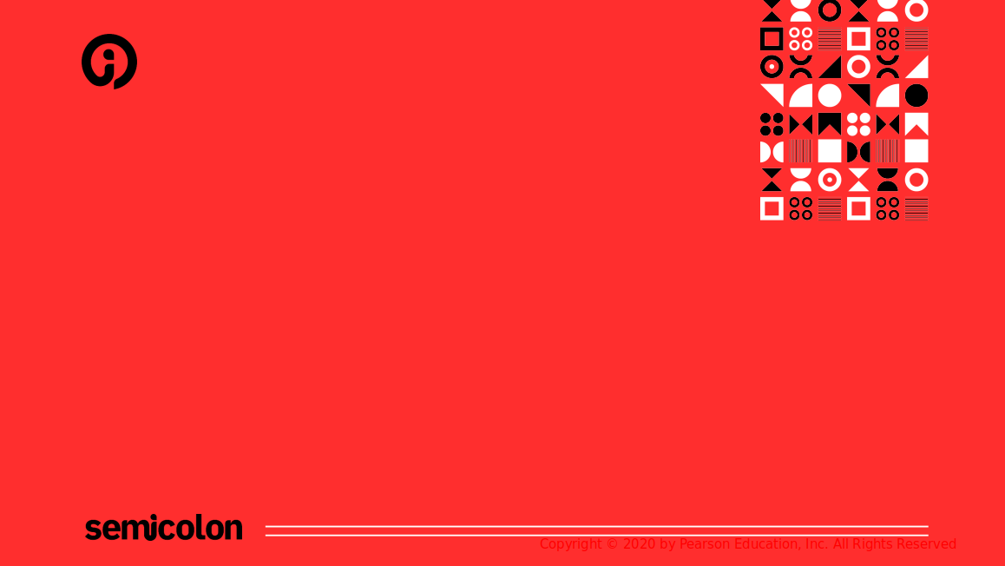
End
Questions and Answer

